Slide 1

Churn Prediction Analysis
Group 7 Section 003
Aashutosh Sehgal – 0780170
Dattu Reddy Pedholla - 0782042
Devashish Patel – 0781214
Rachna Rachna – 0782821
Rohit Rohit - 0773987

Slide 2
Overview Of Problem
Customer churn is the measure of how many customers stop using the service/product during a certain time period. For every organization/company, it is very important to know the churn rate and the factors affecting the churn rate. In this project, we will try to determine the reasons of customer churn and suggest ways to reduce them.

Slide 3
Review of Data Source
The dataset contains 7043 rows and 21 columns. Each row represents a customer, and each column contains customer’s features described on the column metadata. Description for each feature is given below:
Churn- Customers who left the company.
Customer ID- Unique ID of the customer.
Gender – Male or Female.
Senior Citizen – Customers who are senior citizens.
Partner – Customers with partner.
Dependents – Dependents who are customers.
Tenure – How long they have been customers of the company.
Streaming movies – Customers who have employed the streaming movies service.
Phone service – Customers who have employed the phone service.
Multiple lines – Customers who have employed multiple lines.
Internet service – Customers who have employed the Internet service.

Slide 4
Online security – Customers having online security.
Online backup – Customers having online backup.
Device protection – Customers who signed up for device protection.
Tech support – Customers using tech support service.
Streaming TV – Customers streaming TV service.
Paperless billing – Customers who opted for paperless billing.
Payment method – Payment methods used by the customers.
Contract – Contract length of customers with the company.
Total charges – Total charges paid by the customer.
Monthly charges – Monthly charges paid by the customer.
In data cleaning, first, we replaced blank spaces with null values and then we dropped those rows containing null values. We replaced “no internet service” to “No” for the columns named as Online security, Online Backup, Device Protection, Tech Support , Streaming TV and Streaming Movies. We also replaced values in Senior Citizen column from “Yes” or “No” to 1 and 0 respectively. In addition, we converted the data type of tenure column to categorical, by doing the following'Tenure_0-12', 'Tenure_24-48', 'Tenure_12-24', 'Tenure_gt_60', 'Tenure_48-60’.

Slide 5
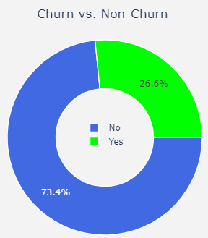
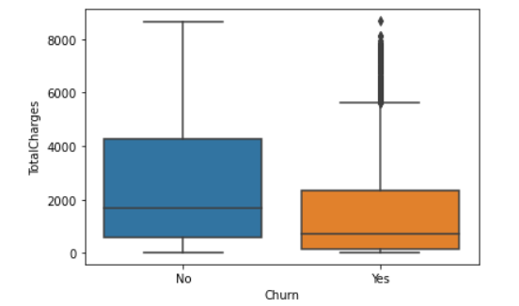
Descriptive Insights
Distribution of Overall Churn
Most of the customers are willing to stay with the company but the customers that have left were high paying customers and a lot of benefits could be reaped from them. So, we need to focus on reducing churn.
The given plot suggests that 73.4% of our customers will not leave the company, whereas 26.6% will.
Outliers are observations that lie abnormally distant from other values in a random sample of the population.
The given boxplot shows the presence of outliers in the churn category, indicating that there are some customers who have paid high total charges in the range of 6000-8000 but have decided to leave anyway.

Slide 6
Results
We created various Machine Learning models to identify the most important features responsible for churn, and the results are shown below:
Accuracy of the Logistic Regression Model is around 80%. Accuracy of the Decision Tree Model is around 73%.
Whereas for K folds cross validation (10 Folds):
Accuracy ranges between 78% and 83%.
Based on the above results, we can consider the Logistic regression Model to be the best fit for our problem.
Based on the visualizations and the results of the machine learning models, we can conclude that the following characteristics are primarily responsible for customer churn.
1. Contract month-to-month
2. Fiber Optic Internet Service
Along with other factors of lesser importance as compared to these two factors.

Slide 7
Interpretation
Based on the data analysis, we can interpret the following:
1) Partner Distribution
More than 1/3rd of the customers that churned away had partners which means that these customers are not happy with the current services of Telco.
2) Multiple Lines:
We can see that 54.5% of the customers that left did not have multiple lines installed. This was split between 2 sub-categories: 9.1% that did not have a phone service at all and 45.4% that did not have multiple lines.
3) Fiber Optic Connections:
We can see that the customers that left had the highest percentage(69.4%) of Fiber Optic Connections.
4) Online Security, Online Backup, Device Protection and Tech Support:
We can see that the customers do not trust Telco to keep their data and usage of services secure as more than 70% of the customers in the churn category in the distribution of each of these individual services did not employ these 4 services.
5) Streaming TV and Streaming Movies:
We can see that more than 56% of the customers in the churn category in the distribution of each of these individual services did not employ these services.
6) Contract Length:
More than 88% of the customers in the churn category opted for month-to-month contract terms.

Slide 8
Future Recommendations/Proposal
When it comes to marketing to customers having partners, Telco can reap benefits of word-of-mouth publicity of these customers two-fold as compared to customers that do not have partners. Also, there is a good chance that the children of these customers will continue using their services because they have been used by their parents as well.
The customers that opted out of multiple lines is an area where Telco can capitalize. This is because multiple lines would mean that the customers would be willingly paying more hence increasing the company's profits. Telco needs to revamp its marketing strategies in order to focus on this group of customers as customers are unhappy and most probably feeling that the multiple lines are not worth the cost which is why we can see such a phenomenon.
Fiber Optic Connections are higher paying connections and telco needs to change its strategies for these customers to stay. For example, introducing new marketing schemes like discounts, change in subscription terms etc.

Slide 9
Customers that opted out of Online Security, Backup, Device Protection and Tech Support is a niche which can prove to be quite instrumental towards attracting more customers, this is because if the security, protection and backup services are good then more customers will switch to Telco. Good tech support will prevent customers from leaving even after unhappy or unsatisfying experiences as the customers would feel valued.
The Streaming TV and Movies services are highly beneficial services which need to be marketed differently in order to extract maximum benefits as well as attract more customers. Regardless of whether the customer is loyal or leaving, most of the customers are opting out of these services.
Since the above services and changes need to be made, customers are opting for shorter contract options. This change can be motivated by employing the above changes.

Slide 10
THANK YOU

